Slide 1
Cloud Detections and Properties Retrievals in Infrared Hyperspectral Observations Based on Different Machine-Learning Algorithms
Qikai Hu
University of Michigan, Ann Arbor, Michigan, USA
Notes:
Hello, everyone. I feel honored to have the opportunity to share my research. Today I am going to introduce our work on using different machine-learning algorithms for clear-sky detections in infrared hyperspectral observations: assessment and physical interpretability.

Slide 2
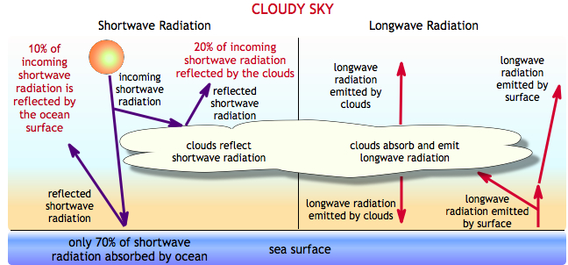
Introduction – Why cloud detection?
Clouds cover approximately 60–70% of Earth’s surface.
The impact of clouds on radiative processes is critical to Earth’s energy budget.

Slide 3
Introduction – Why cloud properties?
Generally, clouds with different properties comes with different effect: low-level, optically thick clouds exert a negative net radiative forcing (cooling), while high-level clouds often result in a positive net radiative effect (heating).
Cloud properties, including cloud fraction and cloud top height can better define the radiative effect accurately.

Slide 4
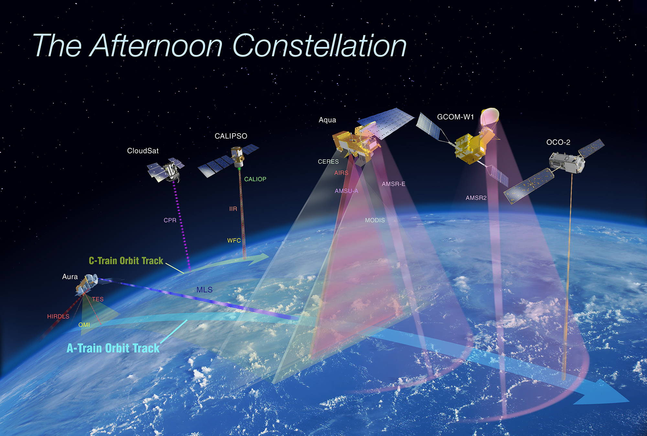

Data
Data:
Input: AIRS brightness temperature (BT) from 1,551 thermal infrared channels
Target: MODIS cloud properties, including cloud mask, cloud top height.
Accessory input: HadCRUT sea surface temperature (SST)
Data Selection:
Nadir view
Tropical ocean
Data Processing:
Collocation of AIRS footprint
Normalization $X′=\frac{X−\overline{X}}{\sqrt{S(X)}}$
Image from NASA (https://atrain.nasa.gov/)
Notes:
We used AIRS brightness temperature from 1,598 thermal infrared channels as our primary predictors, and HadCRUT sea surface temperature as the auxiliary predictor. Models were trained against CERES-MODIS cloud flags. We selected only nadir view and tropical ocean samples. Due to the differences in CERES and AIRS footprints, a collocation strategy shown in the figure is used. Bigger circles represent CERES footprints, while small filled circles represent AIRS footprints. From the satellite observations, it is evident that cloudy samples are far more frequent than clear samples. Thus, we sampled the dataset to equate the frequency of two classes and performed other procedures following the standard machine learning guideline.

Slide 5
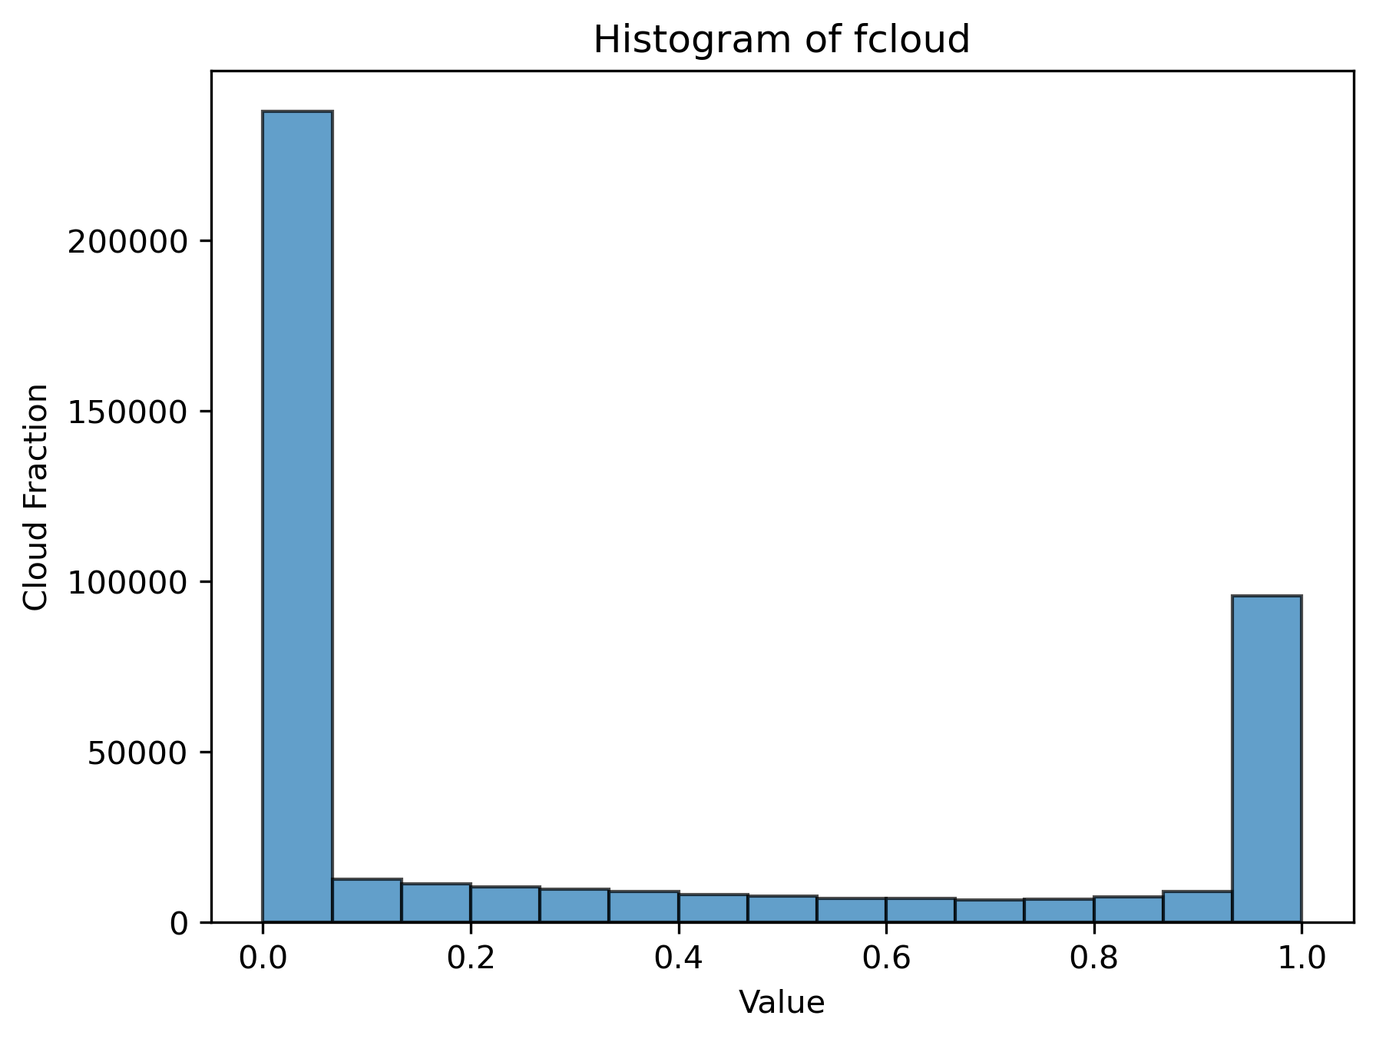
Data
Data:
AIRS brightness temperature (BT) from 1,551 thermal infrared channels
HadCRUT sea surface temperature (SST)
MODIS cloud product, including cloudy/clear-sky, cloud fractions.
Data Selection:
Nadir view
Tropical ocean
Data Description:
446410 points in total.
Few points with cloud fractions 0.1-0.9.
Notes:
We used AIRS brightness temperature from 1,598 thermal infrared channels as our primary predictors, and HadCRUT sea surface temperature as the auxiliary predictor. Models were trained against CERES-MODIS cloud flags. We selected only nadir view and tropical ocean samples. Due to the differences in CERES and AIRS footprints, a collocation strategy shown in the figure is used. Bigger circles represent CERES footprints, while small filled circles represent AIRS footprints. From the satellite observations, it is evident that cloudy samples are far more frequent than clear samples. Thus, we sampled the dataset to equate the frequency of two classes and performed other procedures following the standard machine learning guideline.

Slide 6

Methods – Cloud Detection
Machine learning models:
Linear support vector classifier (LinearSVC)
Random forest classifier
Gradient boosting classifier
Fully-connected artificial neural network (FNN)
Compared to common physically-based algorithms (Chen and Huang, 2016):
Bispectral method (cloudy if $BT_{8μm}−BT_{11μm}>0$)
Thermal contrast threshold method (cloudy if $SST−BT_{max}>σ$)
Notes:
Therefore, our goal in this study is straightforward: we wanted to use machine learning to perform clear-sky detection purely based on the thermal infrared spectrum without the use of any spatial and temporal information. Three popular conventional machine learning models and two neural networks were trained and compared to two physically based algorithms, which use simple physical rules to perform the classification. Here, SST refers to sea surface temperature, while BT refers to brightness temperature. These models are among the most popular and robust ML models that can work satisfactorily in many fields including data assimilation and statistical model downscaling. We deliberately limited the information available to thermal infrared radiances and sea surface temperature when training models. This is to assess the potential of utilizing the information embedded in the full infrared spectrum in the case of cloud classification.

Slide 7
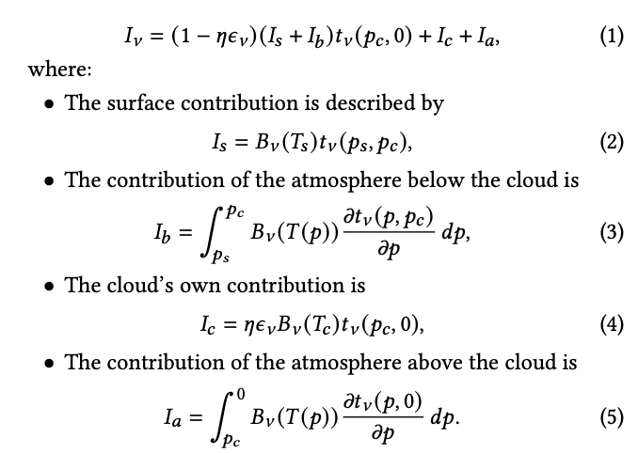
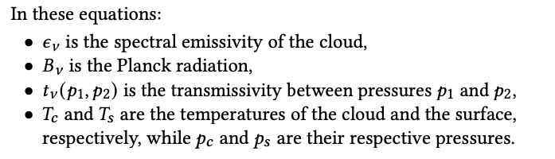
Methods – Cloud Fraction Retrieval
Physics-based Deep Neural Network
Model trained on simulation dataset based on radiative transfer model.
Model tested on the observation dataset.
Notes:
We used AIRS brightness temperature from 1,598 thermal infrared channels as our primary predictors, and HadCRUT sea surface temperature as the auxiliary predictor. Models were trained against CERES-MODIS cloud flags. We selected only nadir view and tropical ocean samples. Due to the differences in CERES and AIRS footprints, a collocation strategy shown in the figure is used. Bigger circles represent CERES footprints, while small filled circles represent AIRS footprints. From the satellite observations, it is evident that cloudy samples are far more frequent than clear samples. Thus, we sampled the dataset to equate the frequency of two classes and performed other procedures following the standard machine learning guideline.

Slide 8
Methods – Cloud Fraction Retrieval
Physics-based Deep Neural Network
Model trained on simulation dataset based on radiative transfer model.
Model tested on the observation dataset.
Bridges the gap between machine learning and traditional physics-based approaches
Allows for the creation of controlled atmospheric scenarios, especially where the cases that are rare to detect in real world.
Real satellite observations often lack precise ground-truth labels for the target variables (e.g., cloud fraction and cloud-top pressure)
5-layer Fully-connected Neural Network
Performance of PCA tested
To test its ability to reduce the overfitting
1,551 thermal infrared channels reduced to 30 features
Notes:
We used AIRS brightness temperature from 1,598 thermal infrared channels as our primary predictors, and HadCRUT sea surface temperature as the auxiliary predictor. Models were trained against CERES-MODIS cloud flags. We selected only nadir view and tropical ocean samples. Due to the differences in CERES and AIRS footprints, a collocation strategy shown in the figure is used. Bigger circles represent CERES footprints, while small filled circles represent AIRS footprints. From the satellite observations, it is evident that cloudy samples are far more frequent than clear samples. Thus, we sampled the dataset to equate the frequency of two classes and performed other procedures following the standard machine learning guideline.

Slide 9
Evaluation – Cloud Detection
Model Name | True Positive | False Negative | True Negative | False Positive | Accuracy
LinearSVC | 78.96% (2) | 15.57% (2) | 4.97% (4) | 0.50% (4) | 83.93% (2)
RF | 74.45% (5) | 20.08% (5) | 5.03% (2) | 0.45% (2) | 79.48% (5)
GB | 75.46% (4) | 19.07% (4) | 4.98% (3) | 0.49% (3) | 80.44% (4)
FNN | 79.06% (1) | 15.46% (1) | 4.92% (5) | 0.55% (5) | 83.98% (1)
Thermal Contrast | 34.14% | 60.39% | 5.47% | 0.00% | 39.61%
Bispectral Algorithm | 21.56% | 72.97% | 5.47% | 0.00% | 27.03%
Traditional physics algorithms perform poorer than all machine learning models
LinearSVC and FNN are slightly superior
Notes:
We trained all models on the equally sampled dataset at year 2004 and evaluated them on the full dataset at year 2008. The table shows the results from the five models. [True positive, false negative, true negative, and false positive]. The numbers in the brackets indicate the ranking of these models. We found that all machine learning algorithms, once trained, can outperform these two physics-based algorithms. Linear support vector machines and 1D-CNN are slightly better than others. Even though the cloudy-sky cases are far more frequent by the ratio of 19:1, by presampling the dataset for training, we achieved a decent balance between cloud detection rate (about 81%) and clear-sky detection rate (about 91%). One interesting thing here is that both empirical methods have a perfect detection for clear-sky cases, no false positive samples. The reason can be found in this histogram, which shows the frequency of clear-sky and cloudy-sky cases with respect to the difference between SST and maximum BT. The thermal contrast algorithm is based on a fact that many thick cloud tops emit longwave radiation at a much lower temperature than the sea surface temperature. If we set a threshold to be 10K, we can decently separate these thick clouds to one side. However, there are also a portion of clouds that do not have a high thermal contrast. Those cases are troublemakers that are confused with clear-sky samples.

Slide 10
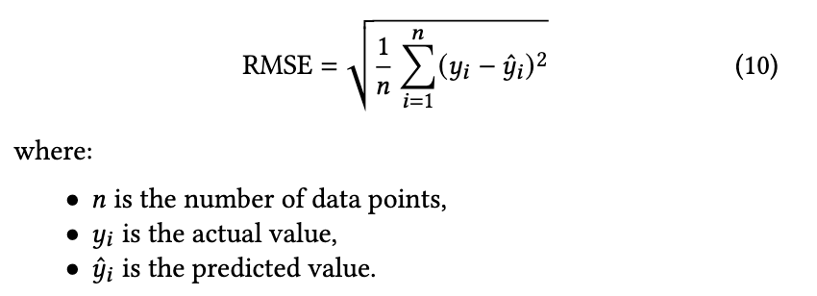
Evaluation – Cloud Fraction Retrieval
Model Name | RMSE (cloud fraction)
DNN | 0.24
DNN + PCA | 0.22
Physics-based DNN | 0.16
Physics-based DNN + PCA | 0.13
Physics-based DNN behaves better than FNN considering RMSE
PCA helps to improve the performance of both FNN and Physics-based DNN considering RMSE
Notes:
We used AIRS brightness temperature from 1,598 thermal infrared channels as our primary predictors, and HadCRUT sea surface temperature as the auxiliary predictor. Models were trained against CERES-MODIS cloud flags. We selected only nadir view and tropical ocean samples. Due to the differences in CERES and AIRS footprints, a collocation strategy shown in the figure is used. Bigger circles represent CERES footprints, while small filled circles represent AIRS footprints. From the satellite observations, it is evident that cloudy samples are far more frequent than clear samples. Thus, we sampled the dataset to equate the frequency of two classes and performed other procedures following the standard machine learning guideline.

Slide 11
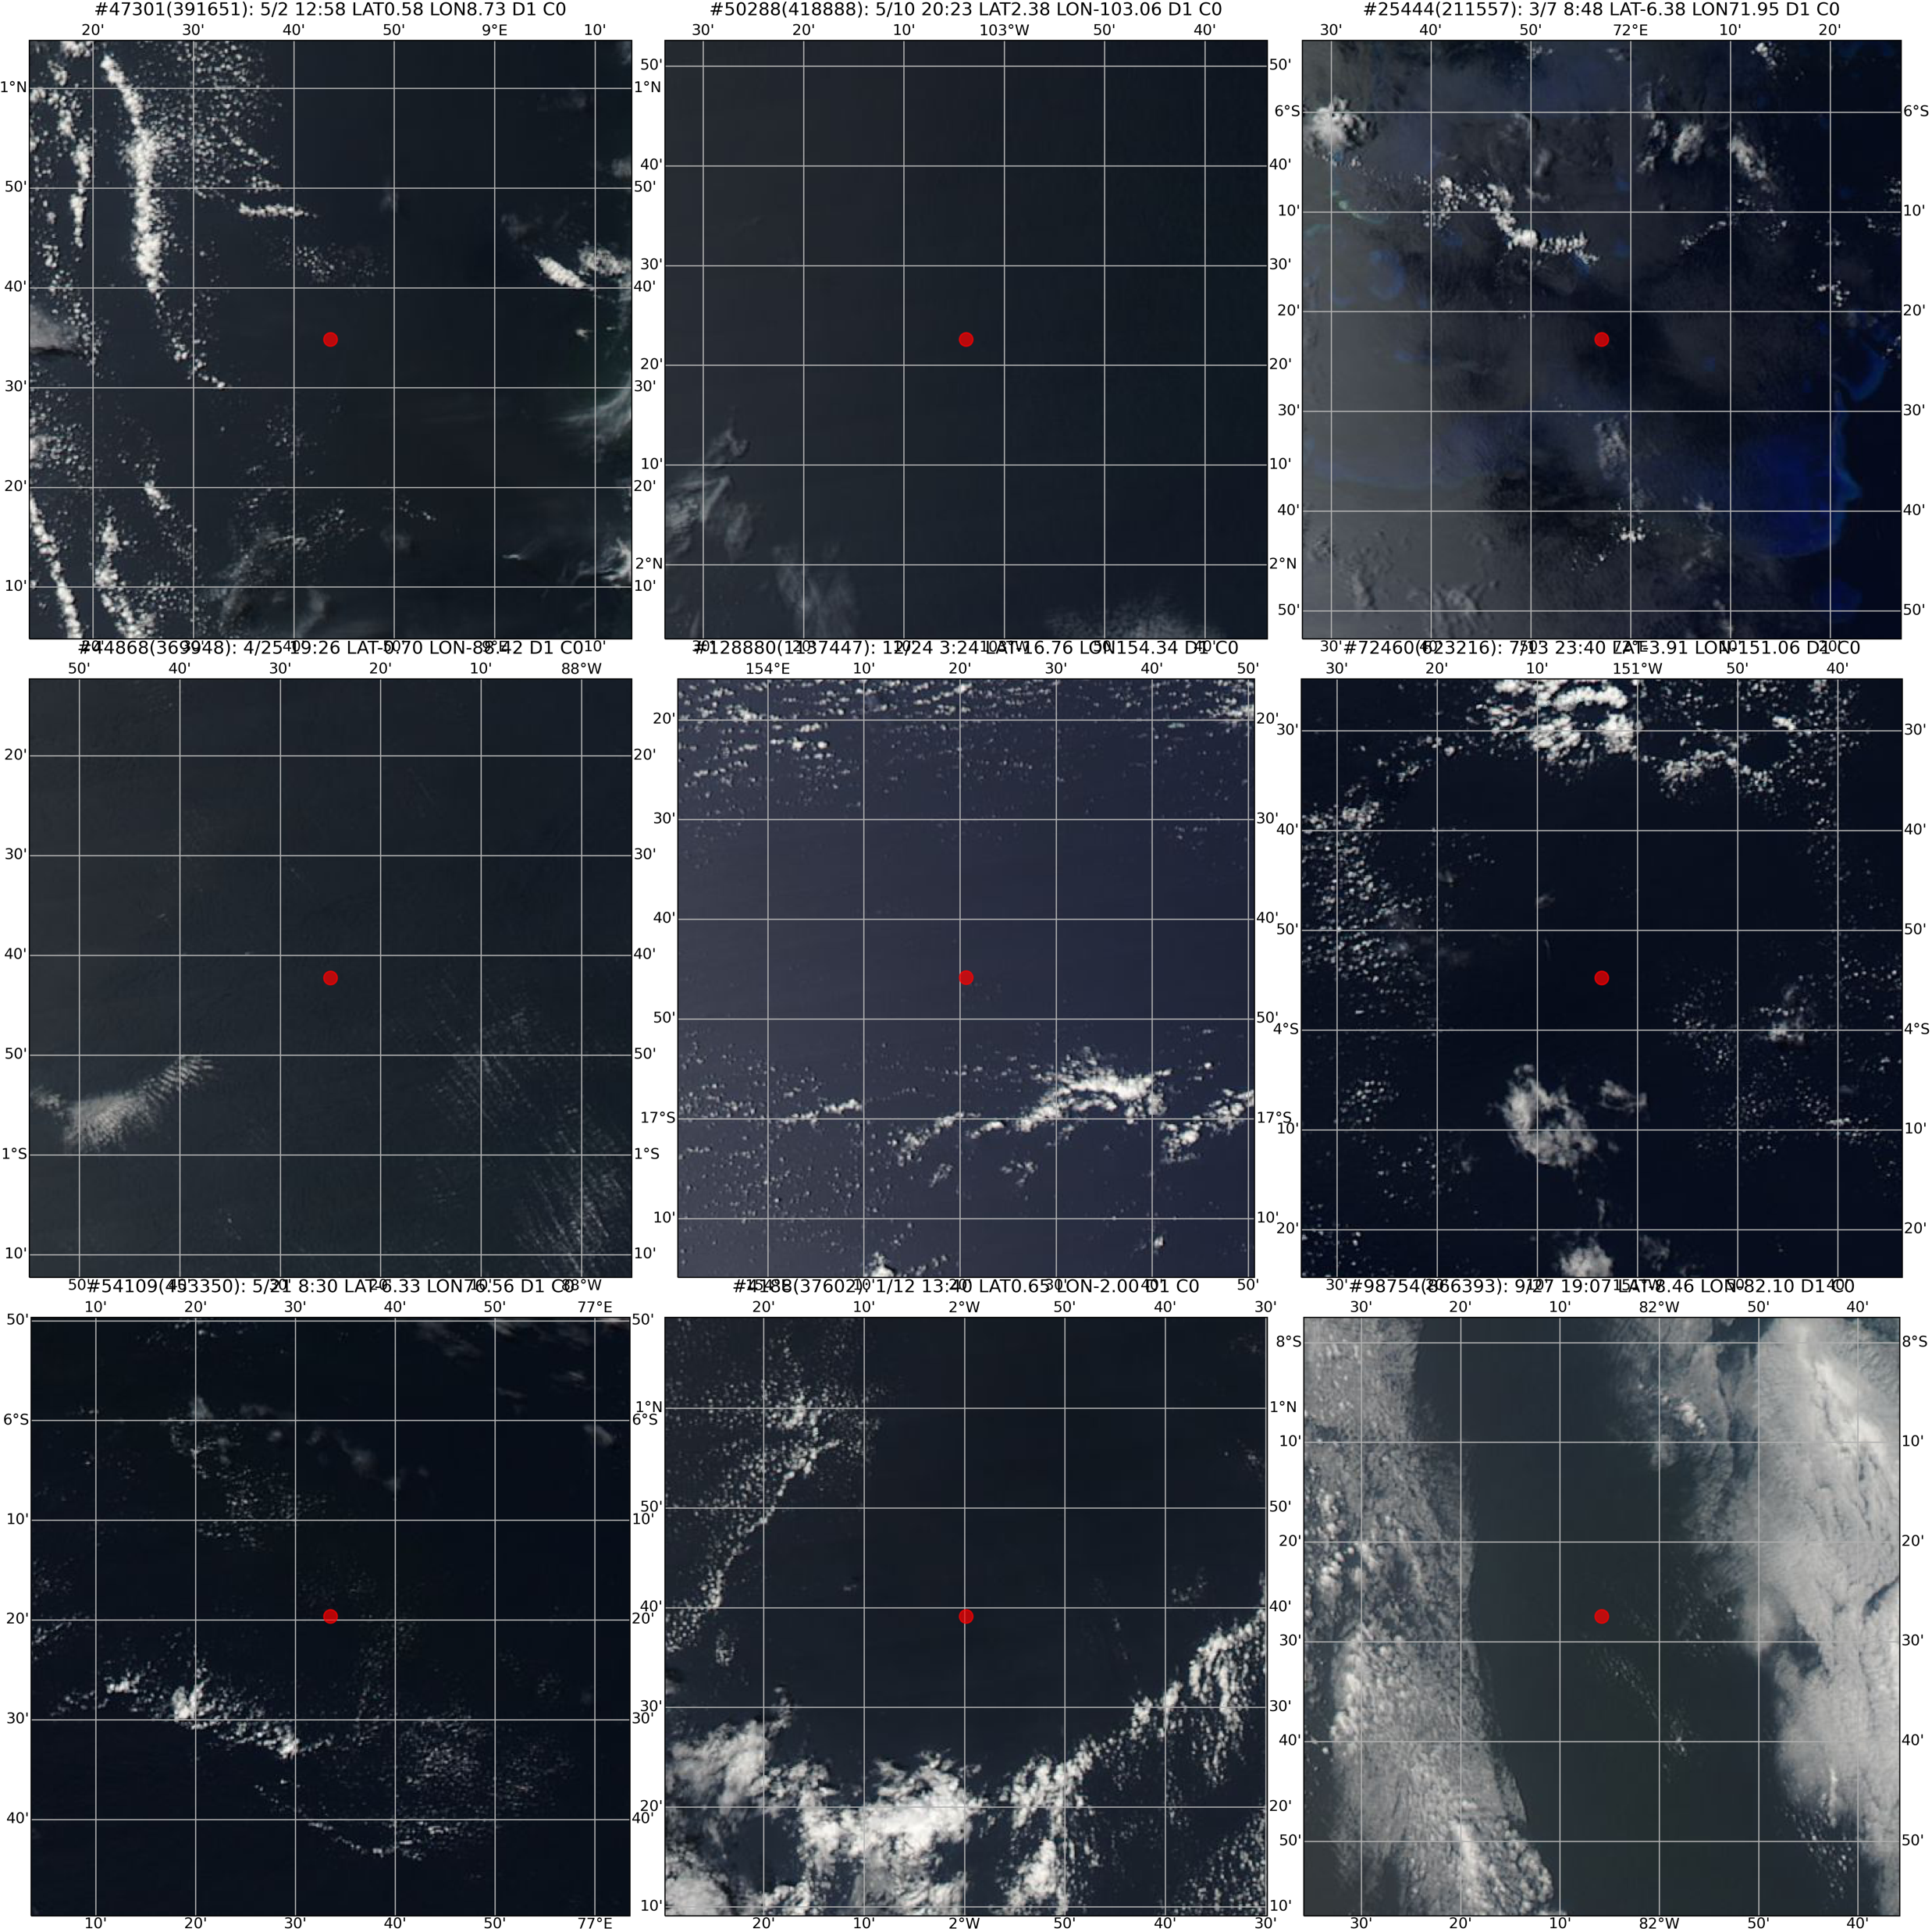
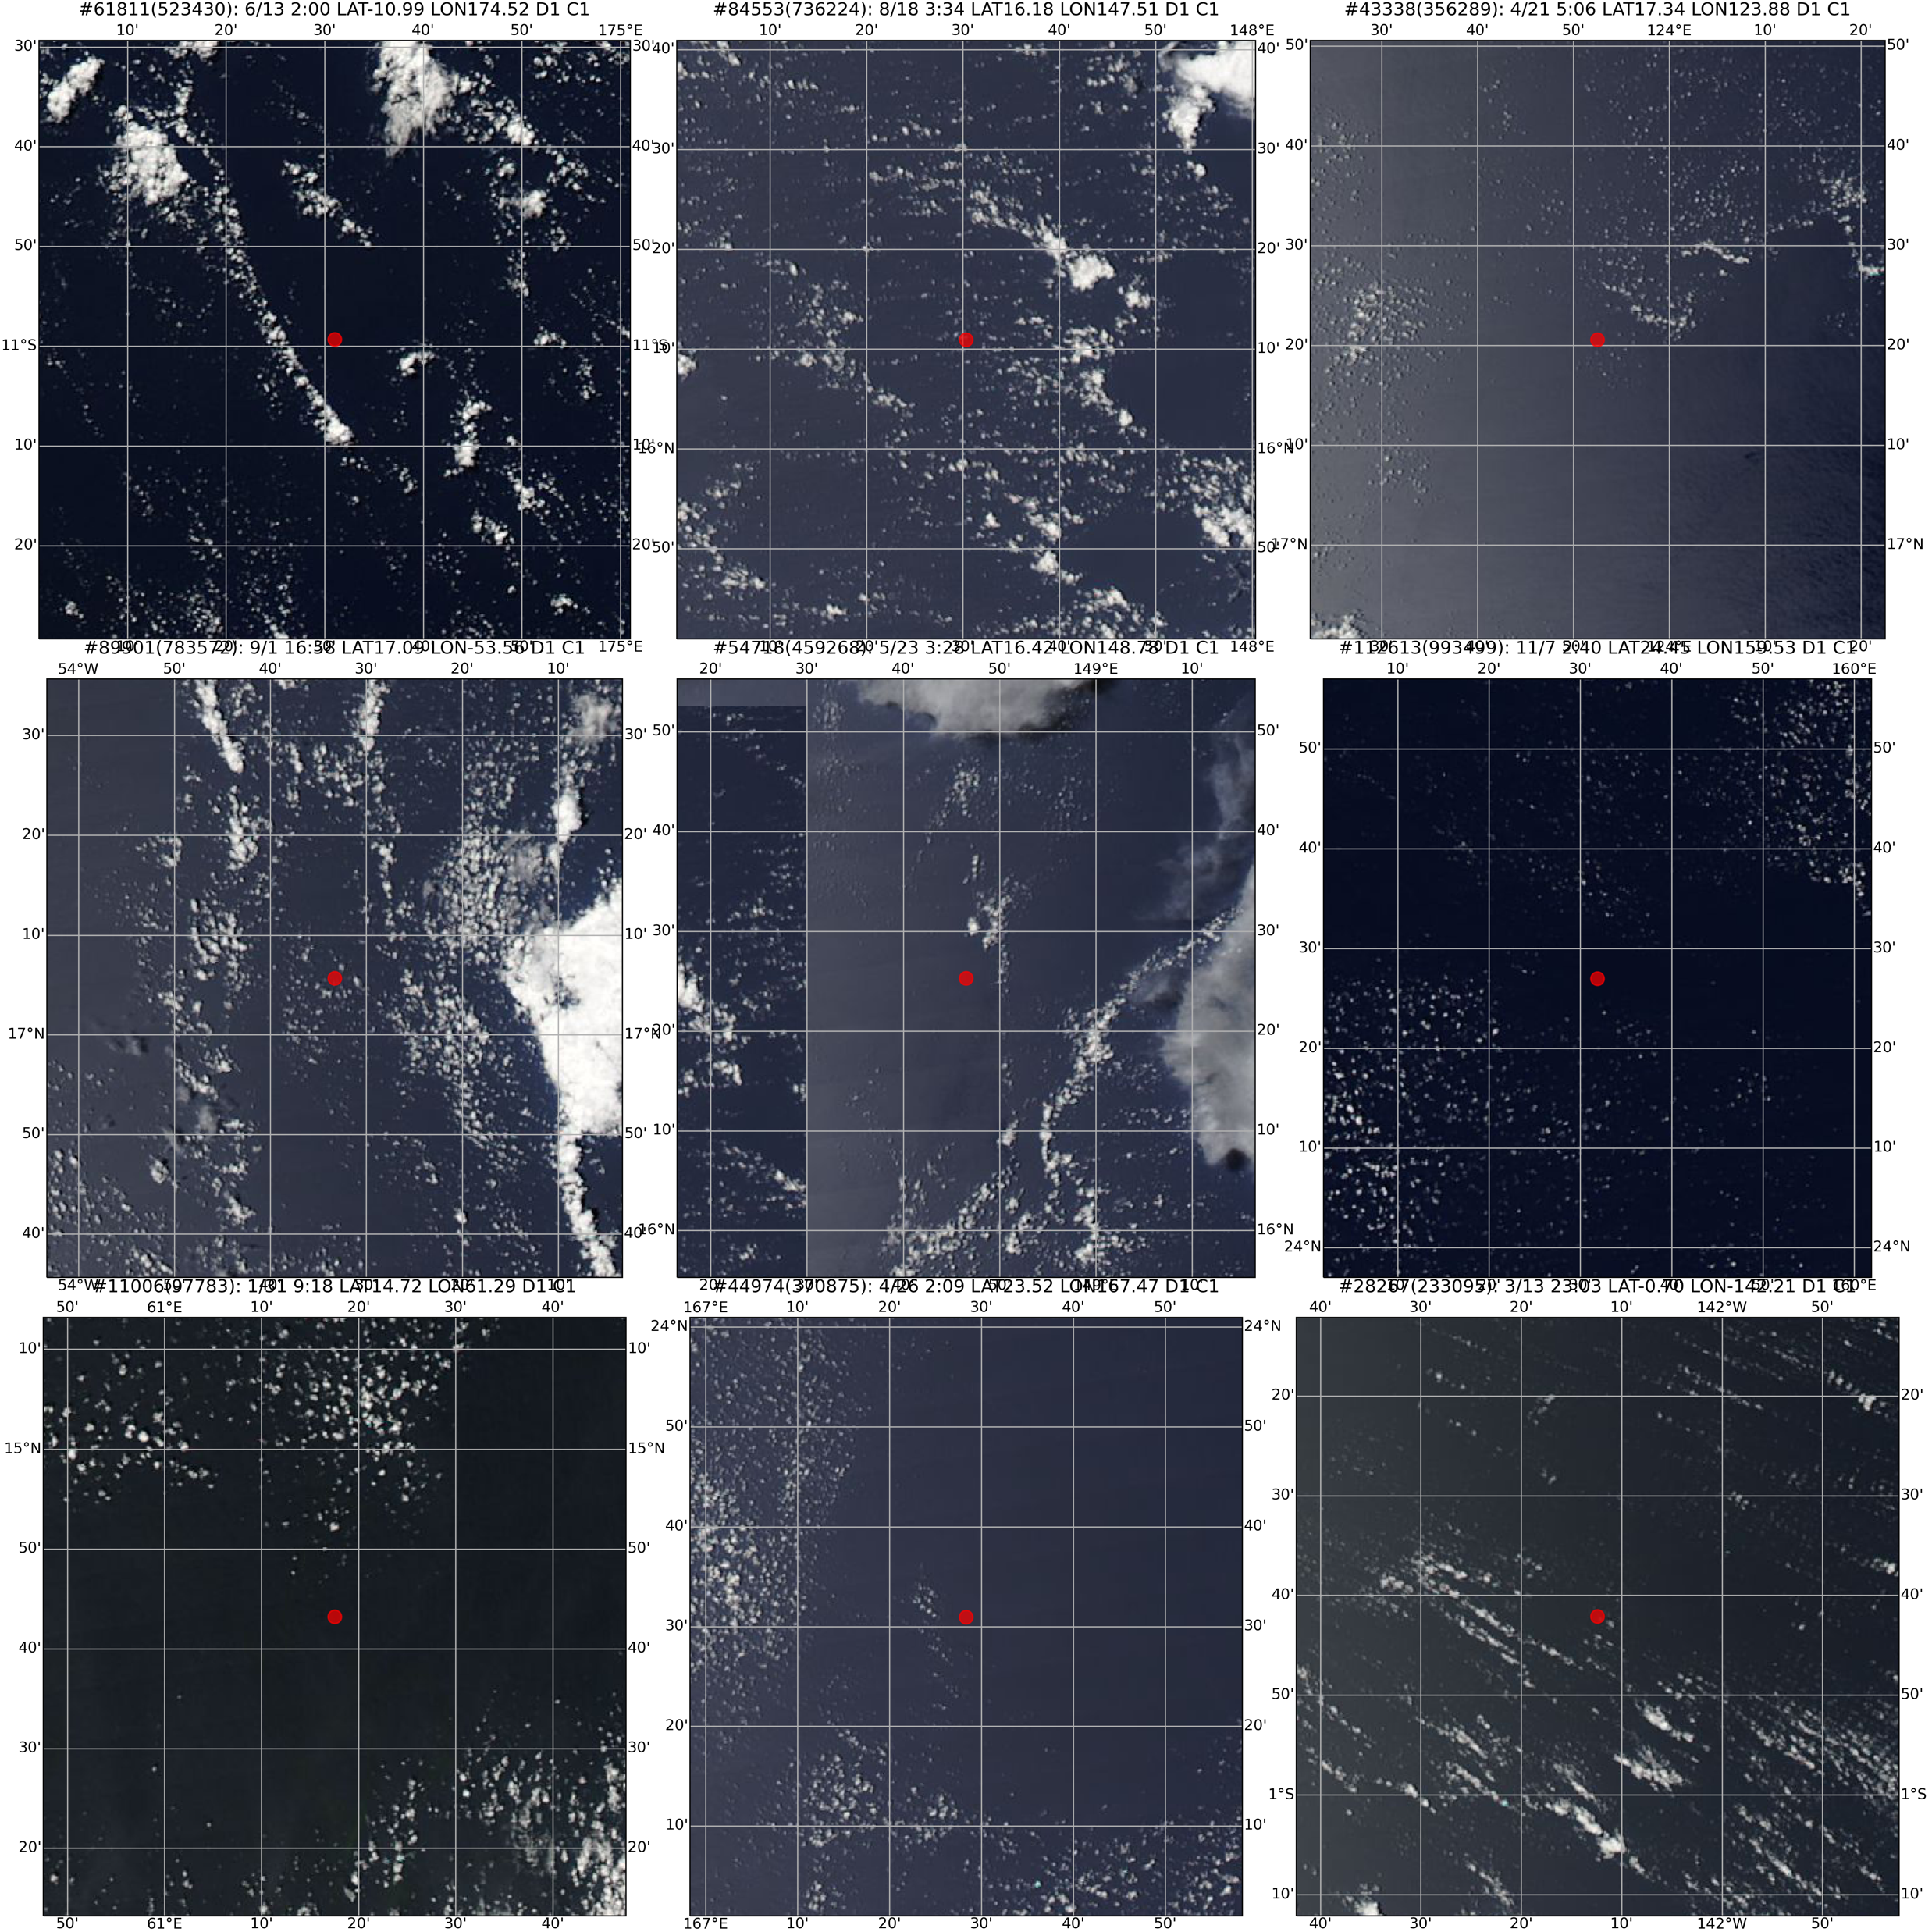
Case Study
Enumerate the cases where models succeed or fail in prediction
Clear-sky Scenes
All models fail
Cloudy-sky Scenes
All models fail
MODIS Corrected Reflectance (True Color) – EOS WorldView
Notes:
To inspect the source of prediction errors, we took advantage of EOS Worldview API and coded a simple interface for case studies. Below are some true-color images of some samples where all models failed to predict well. The red circle at the center of each panel indicates the AIRS footprint.

Slide 12
Conclusion
In the case of cloud detection, ML models outperform empirical algorithms.
Linear SVC and FNN slightly better than others;
Physics-based DNN behaves better than DNN in the cloud fraction detection by using the simulated datasets.
Broken clouds and low clouds are responsible for model errors.
More advanced methods may be applied later.
Pyramid NN, Neural Operators…
Notes:
In summary, we used machine learning to tackle the clear-sky detection problem based on AIRS thermal infrared spectrum, and diagnosed these models via feature importance attribution and case studies. We emphasized the value of these powerful tools in physical interpretability. However, as a preliminary research, we may not fully uncover the full potential of frontier ML techniques. We want to ask, given abundant information in the spectrum, we should answer if it is possible for ML models to reveal more unknown and valuable physical rules to further improve the prediction, while avoid overfitting?

